Slide 1
ksqlDB Architecture
Pravin Y Pawar

Slide 2
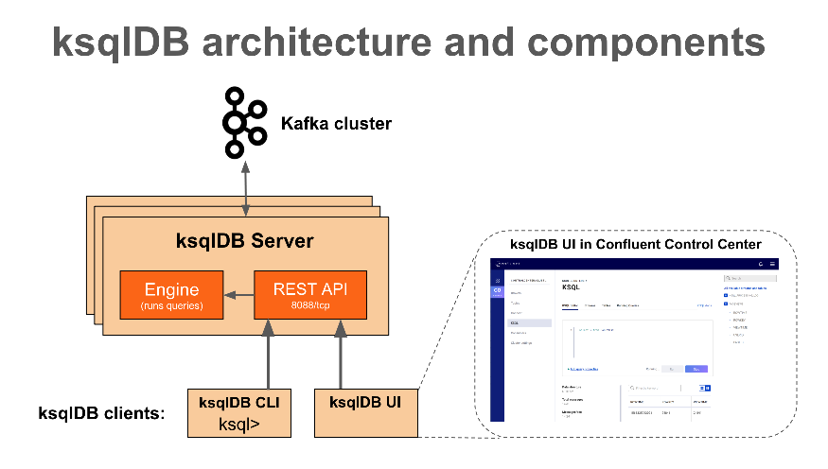
ksqlDB
ksqlDB

Slide 3
Architecture
Can use ksqlDB to build event streaming applications from Apache Kafka topics by using only SQL statements and queries
ksqlDB is built on Kafka Streams, so a ksqlDB application communicates with a Kafka cluster like any other Kafka Streams application
ksqlDB has these main components:
ksqlDB engine -- processes SQL statements and queries
REST interface -- enables client access to the engine
ksqlDB CLI -- console that provides a command-line interface (CLI) to the engine
ksqlDB UI -- enables developing ksqlDB applications in Confluent Control Center and Confluent Cloud
ksqlDB Server
ksqlDB Server comprises the ksqlDB engine and the REST API
ksqlDB Server instances communicate with a Kafka cluster
can add more of them as necessary without restarting your applications

Slide 4
Architecture Components
ksqlDB Server
The ksqlDB server runs the engine that executes SQL queries
includes processing, reading, and writing data to and from the target Kafka cluster
ksqlDB servers form ksqlDB clusters and can run in containers, virtual machines, and bare-metal machines
can add and remove servers to/from the same ksqlDB cluster during live operations to scale ksqlDB's processing capacity as desired
can deploy different ksqlDB clusters to achieve workload isolation
ksqlDB CLI
Can write SQL queries interactively by using the ksqlDB command line interface (CLI)
acts as a client to ksqlDB Server
For production scenarios, can configure ksqlDB clusters to run in non-interactive "headless" configuration, which prevents access from ksqlDB CLI
REST Interface
The REST server interface enables communicating with the ksqlDB engine from the CLI, Confluent Control Center, or from any other REST client

Slide 5
ksqlDB Server
Scale-out
When you deploy your ksqlDB application, it runs on ksqlDB Server instances that are independent of one another, are fault-tolerant, and can be scaled with load.

Slide 6
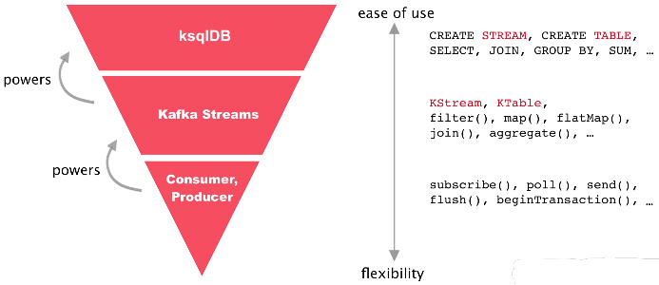
ksqlDB and Kafka Streams
ksqlDB is the streaming database for Apache Kafka
With ksqlDB, you can write event streaming applications by using a lightweight SQL syntax
Kafka Streams is the Kafka library for writing streaming applications and microservices in Java and Scala
ksqlDB is built on Kafka Streams, a robust stream processing framework that is part of Kafka.
can implement custom logic and aggregations in your ksqlDB applications by implementing user defined functions (UDFs) in Java
ksqlDB

Slide 7
ksqlDB Deployment Modes
Can use two modes to deploy ksqlDB streaming applications:
Interactive
data exploration and pipeline development
Headless
long-running production environments
In both deployment modes,
ksqlDB enables distributing the processing load for ksqlDB applications across all ksqlDB Server instances
can add more ksqlDB Server instances without restarting applications

Slide 8
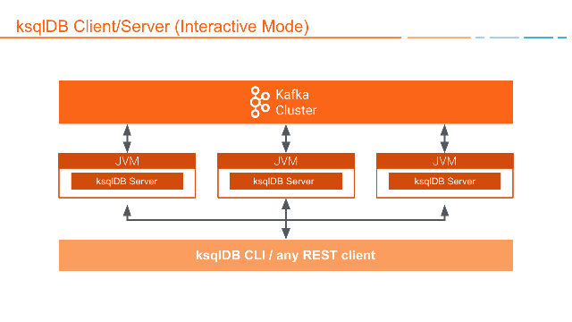
Interactive Deployment
Use the interactive mode to develop ksqlDB applications
the REST interface is available for the ksqlDB CLI and Confluent Control Center to connect to
In interactive mode, one can:
Write statements and queries on the fly
Start any number of server nodes: <path-to-confluent>/bin/ksql-server-start
Start one or more CLIs or REST Clients and point them to a server
Command Topic
In interactive mode, ksqlDB shares statements with servers in the cluster over the command topic
The command topic stores every SQL statement, along with some metadata
ensures the statements are built compatibly across ksqlDB restarts and upgrades
ksqlDB

Slide 9
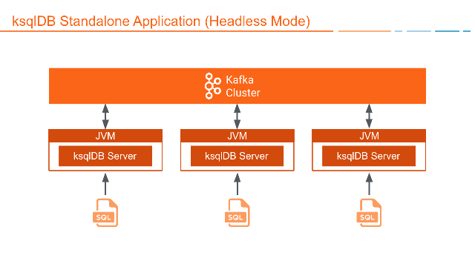
Headless Deployment
Use headless mode to deploy ksqlDB application to a production environment
the REST interface isn't available, so need to assign workloads to ksqlDB clusters by using a SQL file
The SQL file contains the SQL statements and queries that define application
Headless mode is ideal for streaming ETL application deployments
In headless mode one can:
Start any number of server nodes
Pass a SQL file with SQL statements to execute
Version-control your queries and transformations as code
Ensure resource isolation
Leave resource management to dedicated systems, like Kubernetes
Config Topic
In headless mode, need to supply SQL statements to each server in its SQL file
But ksqlDB still needs to store some internal metadata to ensure that it builds queries compatibly across restarts and upgrades
ksqlDB stores this metadata in an internal topic called the config topic
ksqlDB

Slide 10
ksqlDB Deployment
ksqlDB

Slide 11
Thank You!
Reference:
ksqlDB Architecture
https://docs.ksqldb.io/en/v0.7.0-ksqldb/concepts/ksqldb-architecture/
In our next session:

